Slide 1

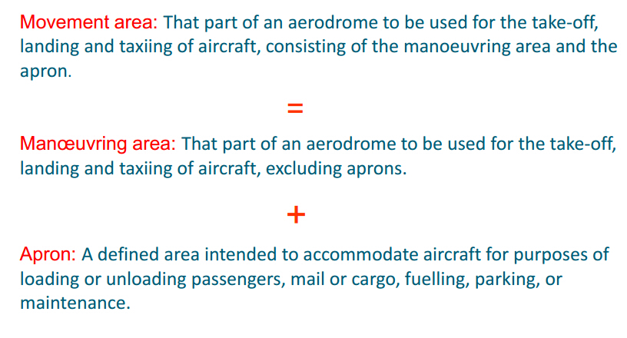
2. Different Areas of Airport
Movement Area 活动区
Maneuvering Area 机动区域

Slide 2
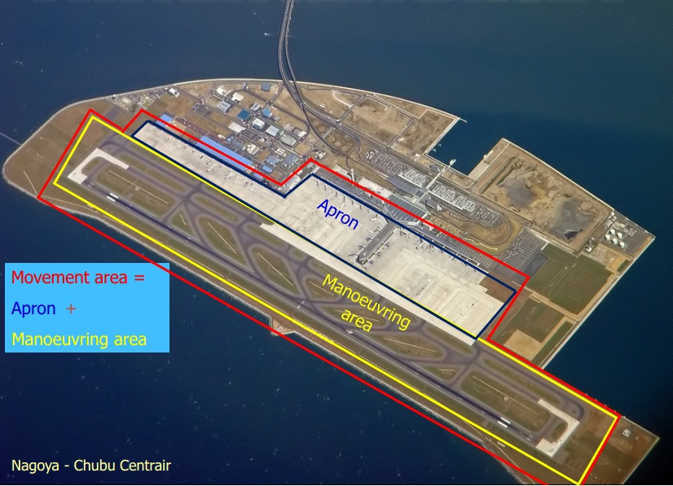
2. Different Areas of Airport

Slide 3

2. Different Areas of Airport
Fixed-base Operator (FBO)
An FBO is a commercial operator supplying fuel, maintenance, aircraft sales, rentals, flight training, handling, and other general aviation services at an airport.
FBO（Fixed Base Operator）位于机场或者邻近机场的为通用航空飞机提供、停场、检修、加油、休息等服务的基地或服务商。

Slide 4

5. Airport Code
ICAO airport code
The ICAO airport code or location indicator is a four-character alphanumeric code designating each airport around the world. These codes are used by air traffic control and airline operations such as flight planning.
ICAO codes are distributed by region and country.
For instance
EGLL: Liverpool John Lennon Airport
ZBAA: Beijing capital international airport

Slide 5

5. Airport Code
ICAO airport code
ICAO codes generally have a regional structure, are not duplicated, and are comprehensive.
In general, the first letter is allocated by continent and represents a country or group of countries within that continent.
The second letter generally represents a country within that region.
The remaining two are used to identify each airport.
The exception to this rule is larger countries that have single-letter country codes, where the remaining three letters identify the airport.

Slide 6
1. The ICAO Methodology of Classifying Airports
Most aviation authorities have International Civil Aviation Organization (ICAO) methodology for using a code system, known as the Aerodrome Reference Code, to specify the standards for individual aerodrome facilities which are suitable for use by aircraft within a range of performances and sizes.
Aerodrome Reference Code 机场基准代号

Slide 7
1. The ICAO Methodology of Classifying Airports
The Code is composed of two elements:
Element 1 is a number related to the aircraft reference field length;
Element 2 is a letter related to the aircraft wing span and outer main gear wheel span.
aircraft reference field length飞行基准飞行场地长度
wing span翼展
outer main gear wheel span 主外轮间距

Slide 8
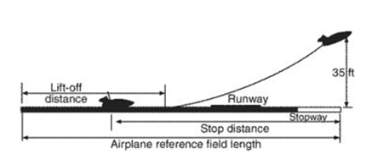
1. The ICAO Methodology of Classifying Airports
Aircraft reference field length, is the minimum field length required for takeoff at maximum certified takeoff mass, at sea level, in standard atmospheric conditions, in still air and zero runway slope, as shown in the appropriate airplane flight manual prescribed by the certificating authority or equivalent data from the airplane manufacturer.
aircraft reference field length飞行基准飞行场地长度
Sourece: http://encyclopedia2.thefreedictionary.com/airplane+reference+field+length

Slide 9
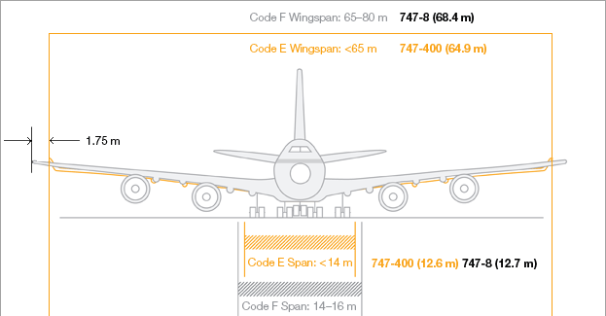
1. The ICAO Methodology of Classifying Airports
outer main gear wheel span
主外轮间距

Slide 10
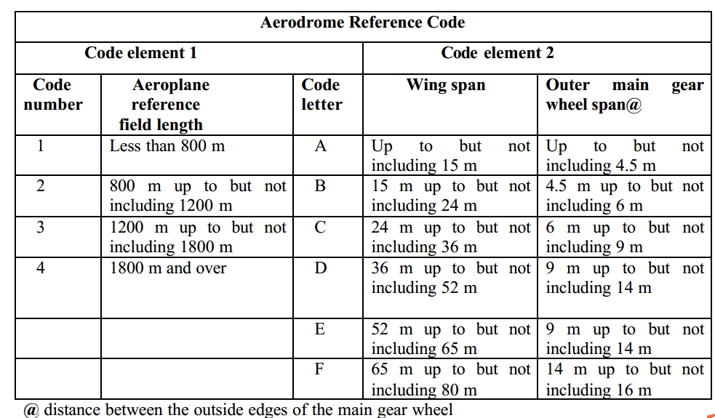
1. The ICAO Methodology of Classifying Airports
The Code number for element 1 shall be determined from column 1 of the table below. The Code number corresponding to the highest value of the aircraft reference field lengths for which the runway is intended is to be selected.
Aerodrome Reference Code 机场基准代号

Slide 11
1. The ICAO Methodology of Classifying Airports
The Code letter for element 2 shall be determined from column 3 of the Table below. The Code letter, which corresponds to the greatest wingspan, or the greatest outer main gear wheel span, whichever gives the more demanding Code letter of the aircraft or which the facility is intended is to be selected.

Slide 12
3. Original destination airport and alternate airport
Alternate airport refers to an airport to which an aircraft may proceed if a landing at the intended airport becomes either impossible or inadvisable.
The alternate airport is for use in case the destination airport becomes unusable while the flight is in progress (due to weather conditions, a strike, a crash, terrorist activity, etc)
Alternate airport 备降机场

Slide 13
3. Original destination airport and alternate airport
Take off alternate: An alternate airport at which an aircraft can land should this become necessary shortly after takeoff and it is not possible to use the airport of departure.
En rout alternate: An alternate airport at which an aircraft would be able to land after experiencing an abnormal or emergency condition en route.
Destination alternate: An alternate airport at which an aircraft may proceed should it become impossible or inadvisable to land at the airport of intended landing.
take-off alternate 起飞备降机场
En route alternate 航路备降机场
Destination alternate 目的地备降机场

